Slide 1
BSA Rifle
Merit Badge
NO LIVE AMMUNITION
in the classroom
NO EXCEPTIONS!
Notes:
Make sure no live ammo. Everyone has Merit Badge paperwork, and Scouts have Blue cards.

Slide 2
NRA Gun Safety Rules
ALWAYS keep your gun pointed in a safe direction
ALWAYS keep your finger off the trigger until ready to shoot
ALWAYS keep your gun unloaded until ready to use
Notes:
Before we do anything else we will go over the 3 basic safety Rules
Click through Rules and have them read them out loud

Slide 3
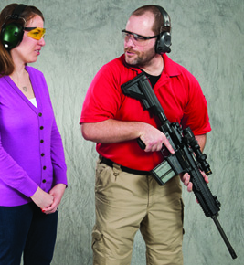
NRA Gun Safety Rules
ALWAYS keep your gun pointed in a safe direction
Notes:
Show safe direction and explain Downrange or in air for our purposes although at ground can be acceptable in some instances
Demonstrate by picking up a rifle and showing them safe direction

Slide 4
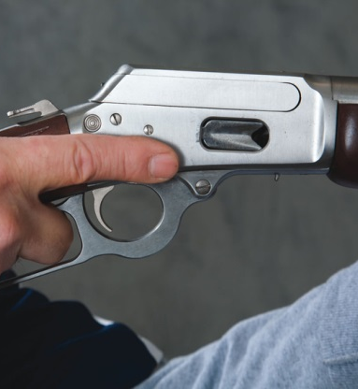
NRA Gun Safety Rules
ALWAYS keep your finger off the trigger until ready to shoot
Notes:
Explain if your finger is off the trigger where should it be. Show them on the side of the trigger guard

Slide 5
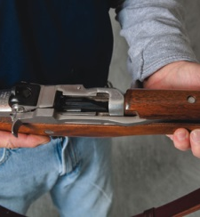
NRA Gun Safety Rules
ALWAYS keep your gun unloaded until ready to use
Notes:
Ask “ how do you know if the gun is unloaded? “
Explain must remove magazine and open action, then lock in chamber
Demonstrate and have someone check the chamber

Slide 6
More Rules for Using a Gun Safely
Make sure those around you are safe
Know your target and what is beyond
Know how to use your gun safely
Be sure the gun is safe to operate
Use Correct Ammunition for gun
Wear Hearing and eye Protection
Notes:
See Merit badge book

Slide 7
What are two major causes of firearm accidents? Handling
Ignorance (a lack of knowledge)
    Ignorance of the rules of safe gun handling
    Ignorance of the proper and safe way to operate a rifle.
Carelessness ( poor or improper attitude)
    Failure to apply the rule of safe gun handling
    Failure to observe proper procedures for safely operating a rifle
I-17

Slide 8
General Range Safety Rules
Know and obey all range rules. (Wait for each command to be given during each exercise.)
Know where others are at all times.
Shoot only at authorized targets.
Stop shooting immediately if you think you may have experienced a malfunction.

Slide 9
BB Guns, Pellet Guns, and Air Soft
BB, Pellet, and Air Soft Guns
Even Air powered guns are not toys. Today’s air guns are technically sophisticated and precise instrument.
Everything you do with a normal Rifle with safe gun handling, shooting stance, fundamentals of firing, hygiene, and etiquette—also applies to air guns.
Notes:
If you treat any gun like a toy you are more likely to treat them all that way. Even cheap air soft guns can damage a persons eye and they will hurt a lot if you get shot with one

Slide 10
Safe Gun Storage.
How would you react if a friend visiting your home asked to see your or your family's firearm(s)?
Ask your parent(s)
Do not touch firearms without an adult present
Notes:
Merit badge pamphlet says we need to store guns so they are not accessible to unauthorized persons.

Slide 11
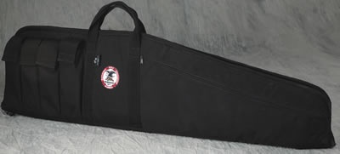
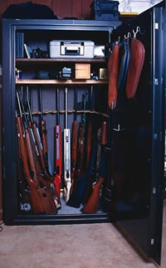
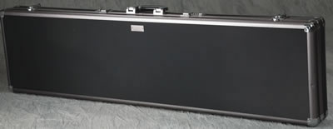
Rifle Storage
Store guns and ammunition so that they are not accessible to unauthorized persons.
Store guns and ammunition separately.
Store guns and ammunition in a cool, dry place.
Soft Case
Safe
Hard Case

Slide 12
Personal Protection Gear (PPE)
Ear Plugs/ Ear Muffs
Safety Glasses
Clothing
Ball Hat
Notes:
Why the need for PPE?
Ear plugs foam in ear, reduces sound more 30-32 Decibels Ear Muffs are less 24-28 decibels but you can buy electronic ones.
Safety glassed must be certified for shooting
Lose clothing can lead to hot brass going where you don’t want it. Long sleeves are better
A ball cap keeps brass from going into your eye even with glasses

Slide 13

Hunting Laws in Nebraska
  Always check local laws
  Must Take Hunter’s Ed if Under 29
  Ignorance is no excuse
  http://outdoornebraska.gov/guides/
Notes:
http://outdoornebraska.gov/hunting/

Slide 14
Hunting and Wise use of renewable Wildlife
  Carrying Capacity
  Population of animals that an area support without being damaged

Slide 15
Shooting Sports
  Local Shooting Leagues
  BSA Adventure Crews
  Project Appleseed
  Game and Parks Leagues and Events
  Cowboy Action
  NRA Marksmanship
Notes:
There’s also competition shoots like 3 Gun, Bench Rest, Tactical AR matches, Military Rifle competition shoots, silhouette shoots. And the list goes on and on.

Slide 16
Hygiene
Wash hands after shooting
Use cold water
Special lead soap if available
Wash hands after cleaning guns or handling
Do not eat or drink while shooting or handling firearms

Slide 17
Where to get more Information
Books
Instructors
NRA website and other websites
Firearms Dealers
Range Safety Officers

Slide 18
NRA Gun Safety Rules
ALWAYS keep your gun pointed in a safe direction
ALWAYS keep your finger off the trigger until ready to shoot
ALWAYS keep your gun unloaded until ready to use
Notes:
Before we do anything else we will go over the 3 basic safety Rules
Click through Rules and have them read them out loud

Slide 19
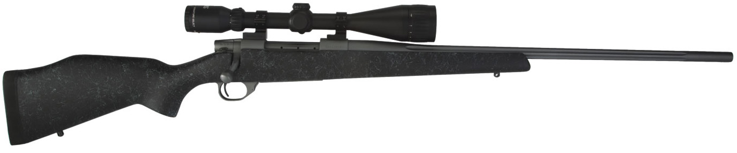
Three Main Parts of Rifle A Rifle
ACTION
(Group of Moving Parts Used to Load, Fire and Unload A Rifle)
BARREL
STOCK
I-7
Notes:
DISPLAY RIFLE WALL CHARTS

Slide 20
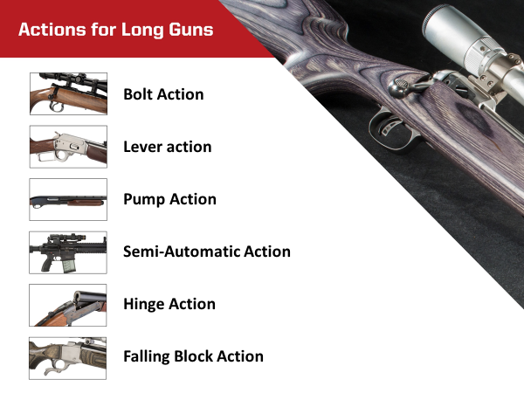

Slide 21
Common Rifle Action Type
Most Common
Bolt-Action
Semi-Automatic
Lever-Action
Slide-Action
Less Common
Falling Block
Rolling Block
Hinge-Action

Slide 22
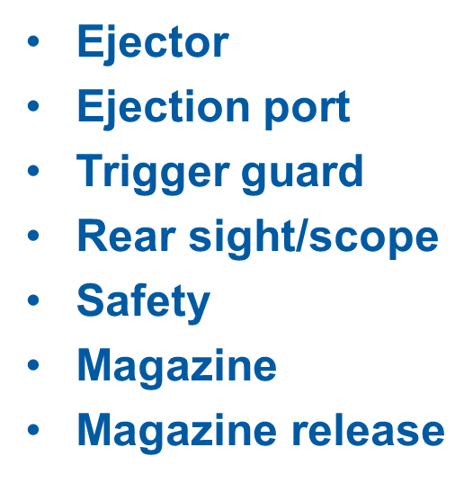
Rifle Action Parts
Receiver
Trigger
Firing pin
Sear
Hammer
Hammer spur
Breech bolt or breech block
Extractor

Slide 23
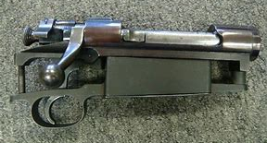
Rifle Action Group

Slide 24
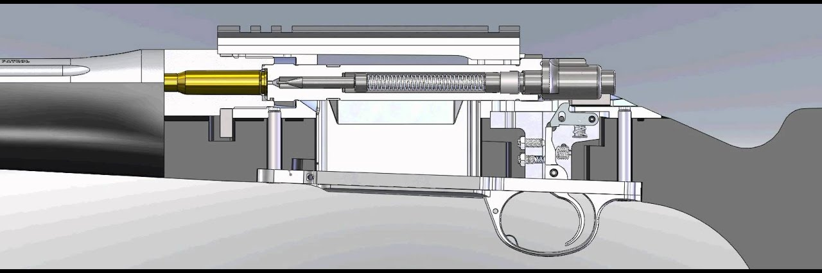
Rifle Action Group

Slide 25
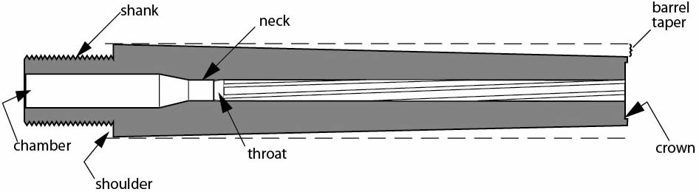
Parts of A Rifle Barrel
Rifling
Land
Rifling
Groove
Muzzle
Bore/
Measure Caliber

Slide 26

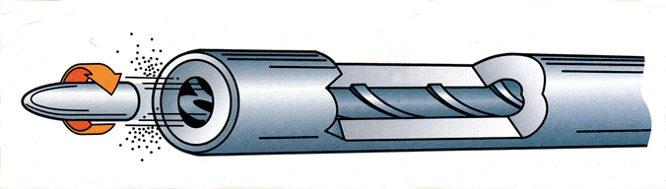
Lands and Grooves
Rifling Spiraling Lands and Groove that Spin the Bullet as it Travels through the Bore.
GROOVE
LAND
LAND
GROOVE
Caliber=Measurement of Diameter of Barrel
MM/CAL 6mm Remington=.244 Remington

Slide 27
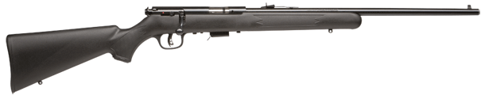
Rifle Parts…Bolt Action
Safety
Chamber
Barrel
Front Sight
Comb
Grip
Bolt
Rear Sight
Butt
Muzzle
Forearm
Box Magazine
Trigger
Bolt Handle
Toe
Trigger Guard
27
Notes:
Discuss different actions, how they work.
Bolt Action
Semi Auto most common
Lever Action
Magazine internal, external , tube feed.
27

Slide 28
NRA Gun Safety Rules
ALWAYS keep your gun pointed in a safe direction
ALWAYS keep your finger off the trigger until ready to shoot
ALWAYS keep your gun unloaded until ready to use
Notes:
Before we do anything else we will go over the 3 basic safety Rules
Click through Rules and have them read them out loud

Slide 29
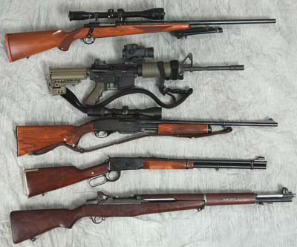
Selecting a Rifle
When considering purchasing a rifle:
Consult knowledgeable shooters
Research and, if possible, test-fire various makes and models
Purchase the rifle from a reputable dealer

Slide 30
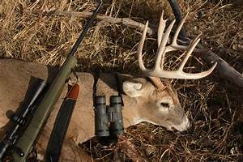
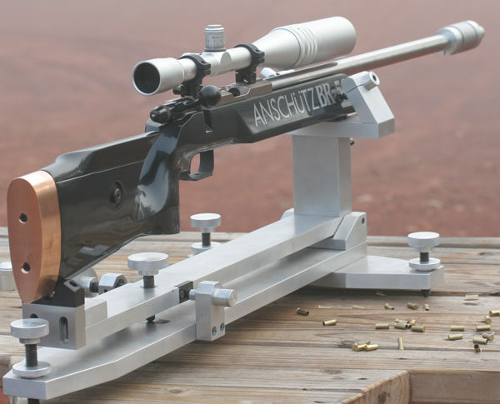
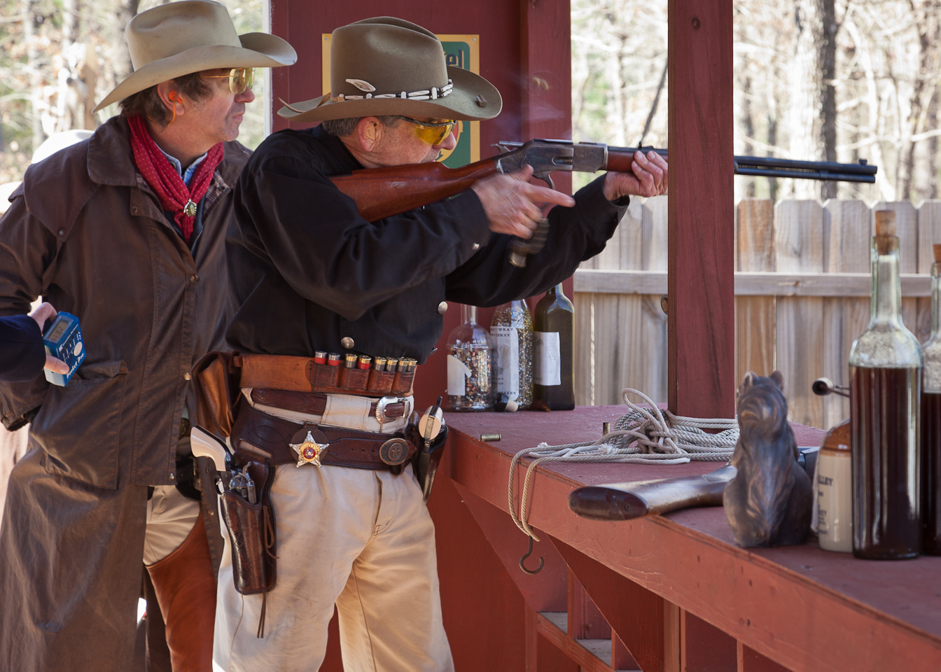
Selecting a Rifle
  Purpose / Use
Notes:
Learn Rifle caliber ballistics, understand required ballistics for the intended use of the gun
Semi-Auto, Bolt Action. Lever Action, Pump Action
Does the gun fit you, is the stock adjustable?
Iron Sights, scope, red dot. Many Rifles don’t come with any sights, others have pretty bad iron sights.

Slide 31
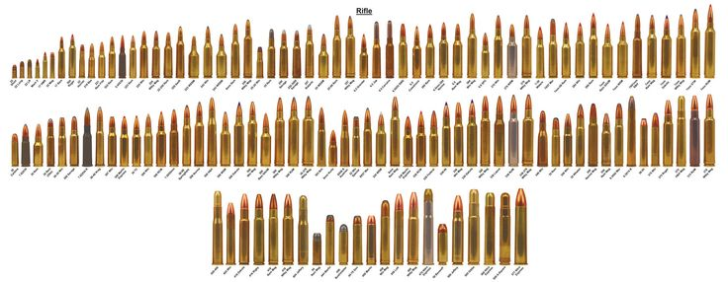
Selecting a Gun
  Caliber
Notes:
Short discussion over different calibers and give an idea of why you want to look at caliber when choosing a rifle.

Slide 32
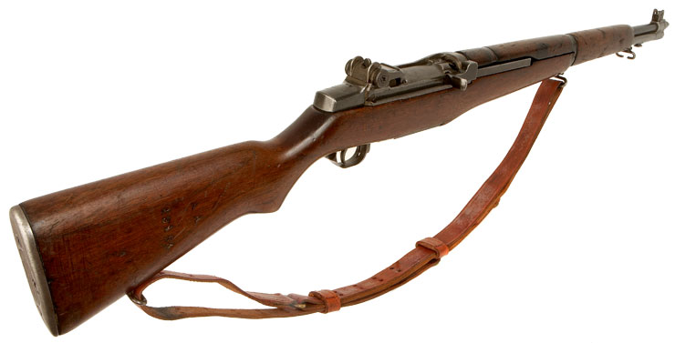
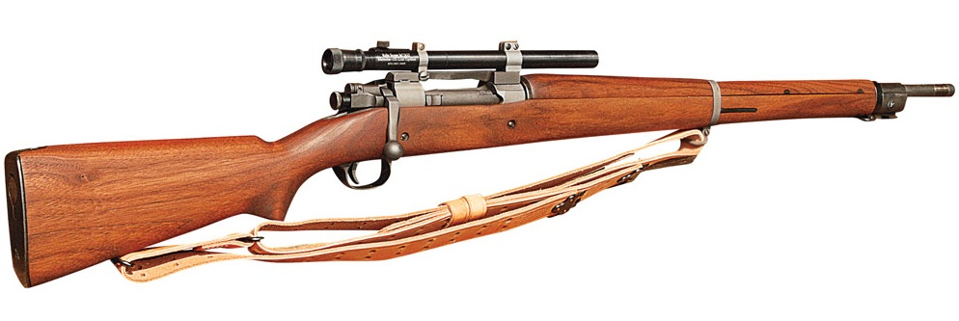
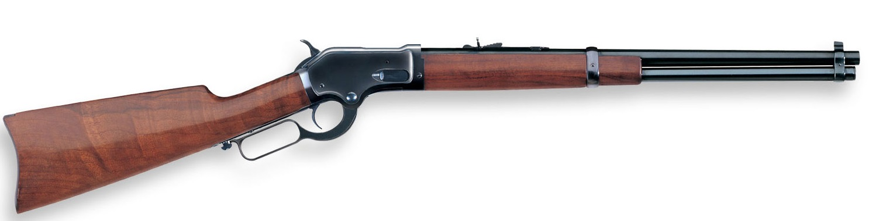
Selecting a Gun
  Action
Semi-Auto
Bolt Action
Lever Action
Notes:
Start with Bolt action rifle ask what it is, then semi-auto, and then lever action

Slide 33
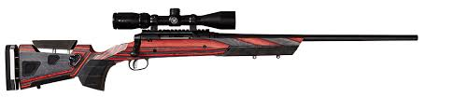
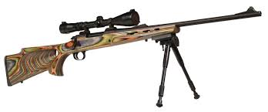
Selecting a Gun
  Stock Fit

Slide 34
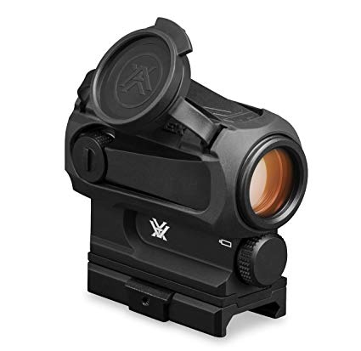
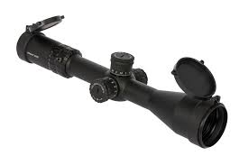
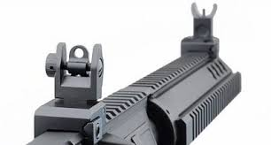
Selecting a Gun
  Sights
Rifle Scope
Iron Sights
Red Dot Sight

Slide 35
NRA Gun Safety Rules
ALWAYS keep your gun pointed in a safe direction
ALWAYS keep your finger off the trigger until ready to shoot
ALWAYS keep your gun unloaded until ready to use
Notes:
Before we do anything else we will go over the 3 basic safety Rules
Click through Rules and have them read them out loud

Slide 36
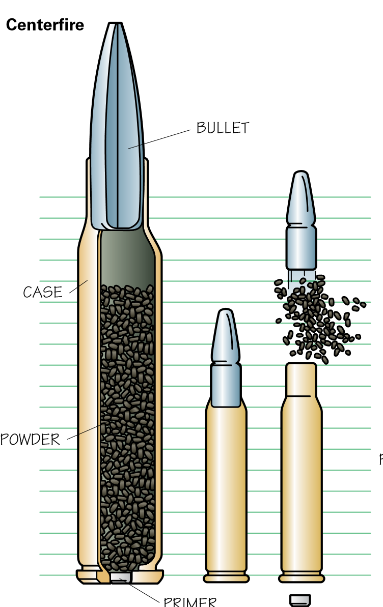
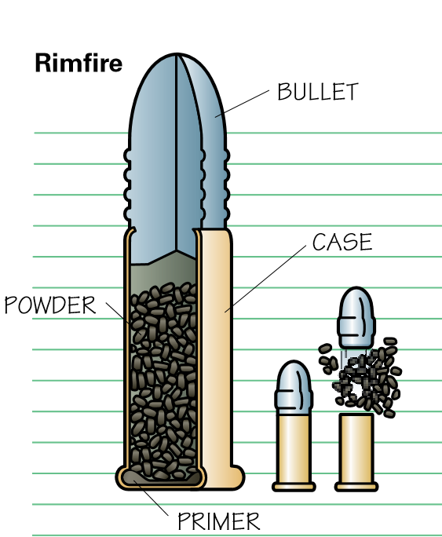
Ammunition
Notes:
Explain the difference between a bullet and cartridge.
Talk about the different components.
Also the differences between centerfire and rim fire
Make sure you use good ammo that’s correct for the gun. See Examples

Slide 37
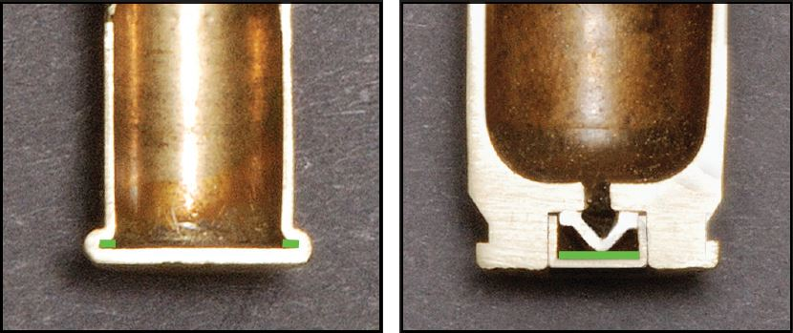
Primers
PRIMER
PRIMER
Rimfire Centerfire
Priming compound is shown in green.

Slide 38
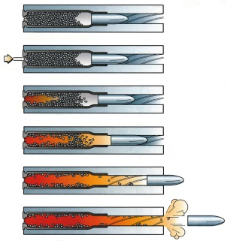

Cartridge Firing Sequenceequence

Slide 39
3 Types of Malfunctions
  Misfire
  Hang Fire
  Squib Load
Notes:
This is the three malfunctions and are explained more in the next slides.

Slide 40
Misfire
  A Misfire is the failure of a cartridge to ignite when the primer or case rim has been struck by the firing pin. This situation may be caused by a defect in the cartridge or by a defect in the rifle that causes a weak firing pin hit.

Slide 41
Hang Fire
  A Hang fire is a perceptible delay in the ignition of a cartridge after the primer or case rim has been struck by the firing pin. This delay may last several seconds.

Slide 42
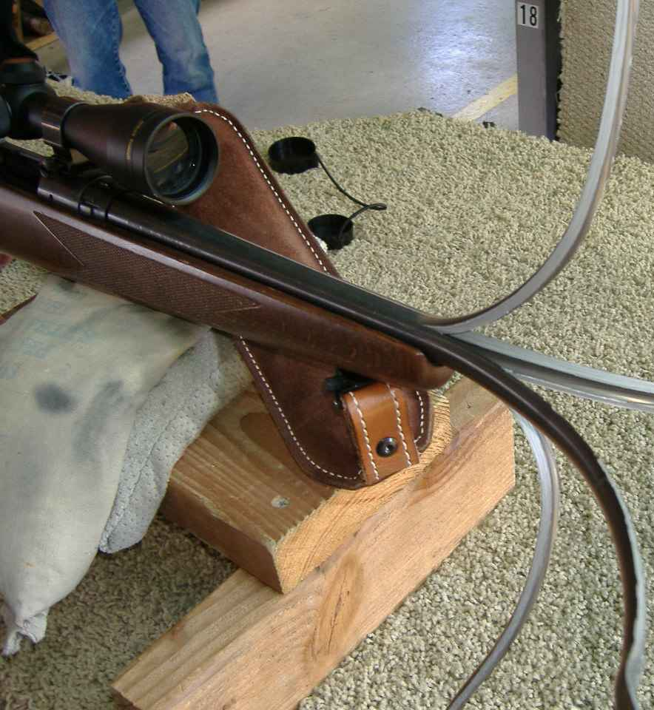
Squib Load
  A Squib Load occurs when the cartridge develops less than normal pressure or velocity after the ignition of a cartridge. Squib loads can cause a bullet to fail to exit the muzzle and become lodged in the bore
Notes:
If your gun doesn’t sound as loud, or you hear someone else's gun not sound right. Call a cease fire. We will check the barrel and make sure we don’t have a squib load.

Slide 43
Cartridge Malfunction
What do you do if you experience a:
Misfire ? Hang fire? Squib Load?
1. Stop firing IMMEDIATELY
2. Maintain your hold on the firearm with your shooting hand keeping the firearm pointed down range.
3. Raise your non-shooting hand in the air
4. Wait for an instructor.
5. Do nothing else until your instructor arrives.

Slide 44
NRA Gun Safety Rules
ALWAYS keep your gun pointed in a safe direction
ALWAYS keep your finger off the trigger until ready to shoot
ALWAYS keep your gun unloaded until ready to use
Notes:
Ask “Primary Concern of handling firearms?” What are major causes of gun accidents?
Lack of knowledge of firearm safety and operation
Failure to apply one’s knowledge
Basically ignorance and carelessness
Click through Rules and have them read them outloud

Slide 45
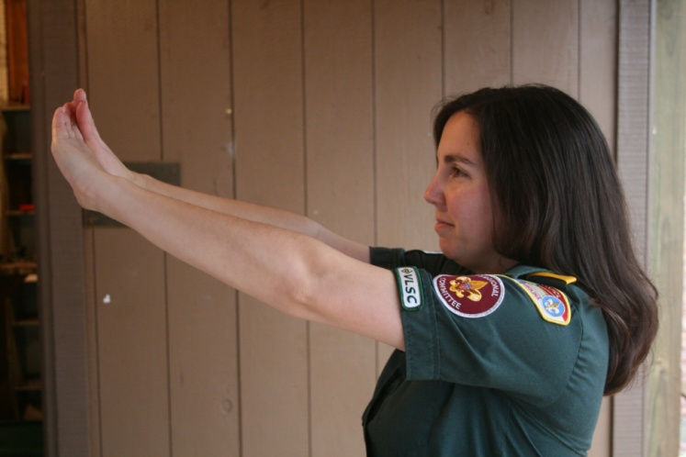
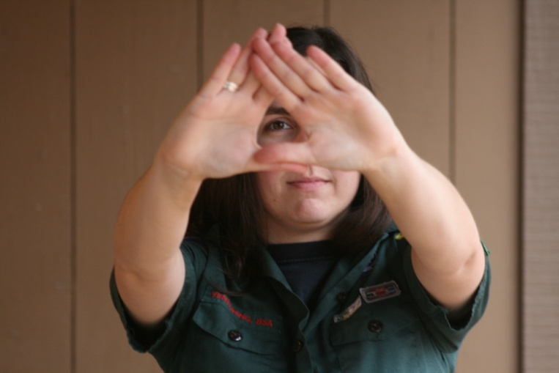
Shooting Fundamentals
Determining the Dominant Eye
Extend arms forward and form opening between the hands
With both eyes open, look at a distant object through opening
Bring hands to face while looking at object – Opening will be aligned with the dominant eye
Notes:
45

Slide 46
Position
A Position is the platform from which all the shooting fundamentals are executed.
A Position should be comfortable, balanced, relaxed and properly aligned with the target.

Slide 47
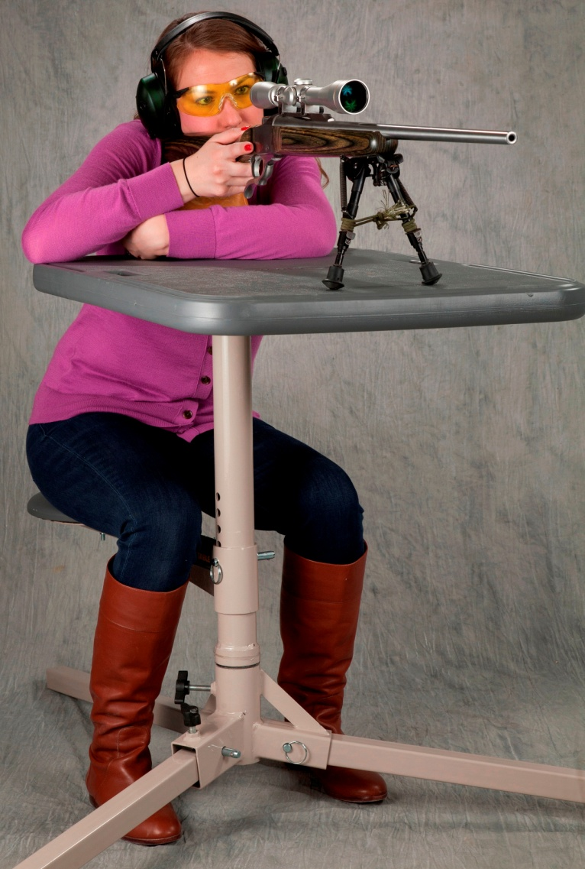
Bench Rest Position
Sit behind the bench facing the target
Both elbows rest on the bench
The firing hand grasps the stock wrist or pistol grip
The head is erect
The butt of the stock is positioned against the shoulder so that the Rifle sights are at eye level.

Slide 48
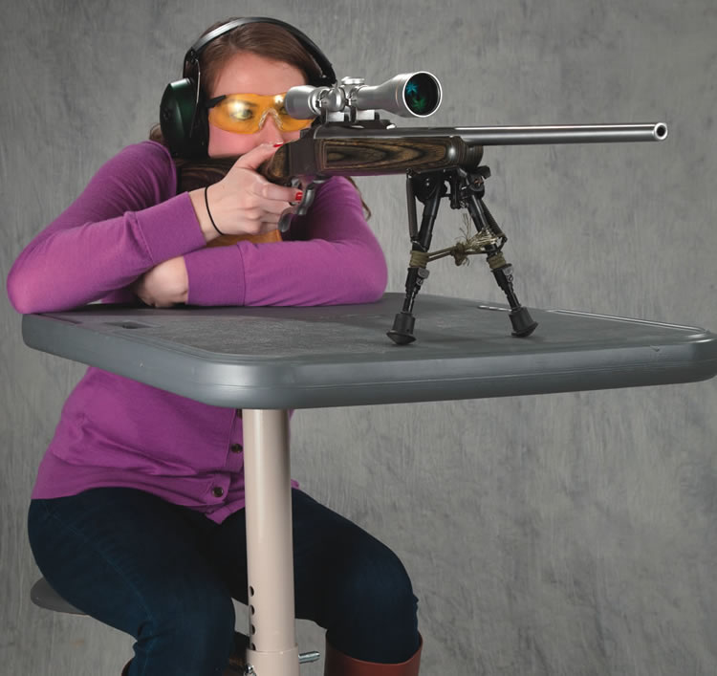
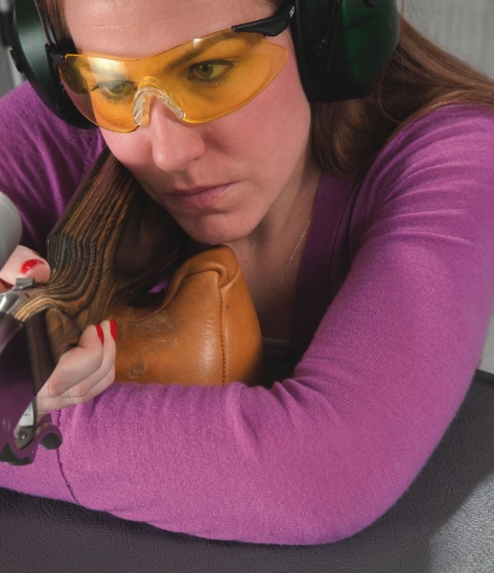
Assuming the Bench Rest Position
Take a seat at the bench facing the target.
Grasp rifle at the wrist or pistol grip with the firing hand, and positions elbows on the bench.
Lay the rifle across the support and rest this hand on the sandbag or other support.
Position the rifle against the face and shoulder so that the dominant eye can look through the sights comfortably and naturally.

Slide 49
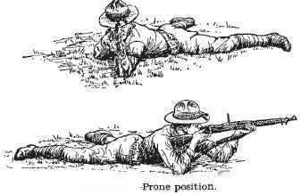
Prone Supported Position
Feet and legs are flat on the ground with the legs relaxed.
Butt of the rifle in the shoulder close to neck.
Elbows on the ground to support the rifle.
Support hand under the Forearm.
Trigger hand.
Face firmly against the stock with eye looking straight down the sights.
Align the position to target.
Notes:
Find good picture or youtube video
49

Slide 50
NRA Gun Safety Rules
ALWAYS keep your gun pointed in a safe direction
ALWAYS keep your finger off the trigger until ready to shoot
ALWAYS keep your gun unloaded until ready to use
Notes:
Before we do anything else we will go over the 3 basic safety Rules
Click through Rules and have them read them out loud

Slide 51
Rifle Shooting Fundamentals
AIMING (sight alignment & sight picture)
BREATH CONTROL
HOLD CONTROL
TRIGGER CONTROL
FOLLOW-THROUGH
Notes:
Just read more information to follow on each of these.

Slide 52
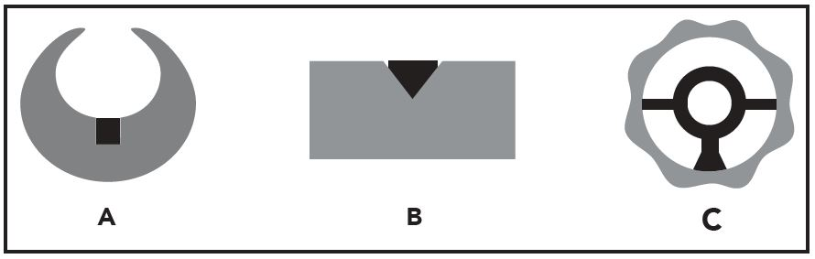
1. Aiming
Aiming consists of two stages: sight alignment and sight picture. Sight Alignment refers to the proper positioning of the shooting eye, the rear sight, and the front sight in relation to each other.

Slide 53


Sight Alignment
Sight alignment refers to the proper relationship of the front and rear sights.
With post-and-notch sights:
The tops of the front and rear sights are even
The front post is centered in the rear notch
Front Sight Rear Sight

Slide 54
Sight Alignment

Slide 55
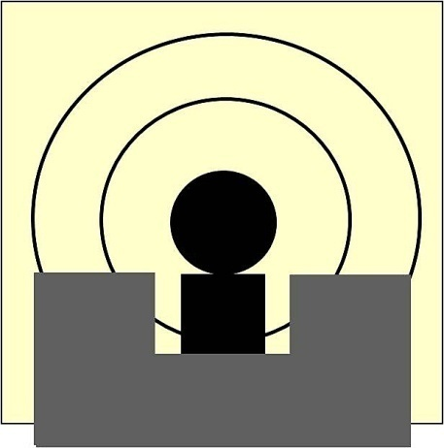

Sight Picture
Proper sight picture is obtained when the aligned sights are put into their proper relationship with the target.
Focus Should Be On The FRONT Sight.
SIX O’CLOCK HOLD
CENTER HOLD

Slide 56
FUNDAMENTALS “Aiming”
Scope
FOCUS ON THE TARGET
  Sight Alignment
  Looking through the scope , You see the whole scope tube (not just small hole in tube)
  Sight Picture
  Cross Hairs are centered on the target

Slide 57
Scope Problems
Eye too close or too far Eye not Centered

Slide 58
FUNDAMENTALS “Aiming”
Aperture Rear and Post Front Sight
FRONT SIGHT IS IN SHARP FOCUS
Sight Alignment
  Aperture Rear and Post Front Sight
  The tops of the front is center in the rear sights aperture
  Sight Picture
  6 O'clock Hold on the Bullseye

Slide 59
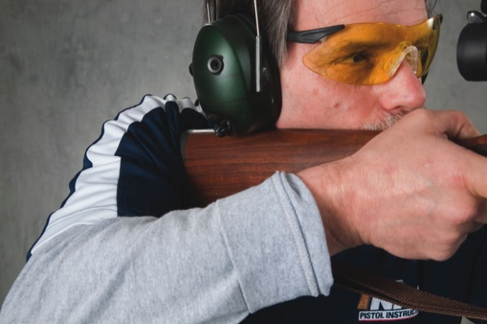
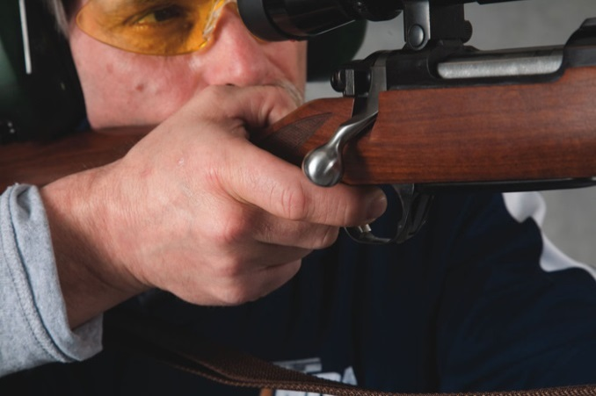
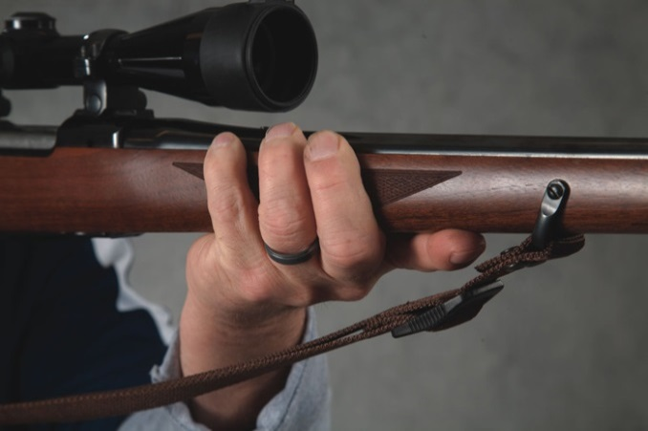
2. Hold Control
Exercising Hold Control allows the shooter to maintain the proper sight picture and sight alignment during the process of firing the shot.
An important factor in hold control is the way in which the rifle is gripped.

Slide 60

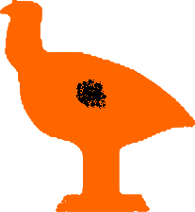

2. Hold Control
It is hard to hold a rifle without some motion; this is called the
“arc of movement.”
One should try to maintain proper sight alignment and sight picture while minimizing the arch of movement. With practice, the arch of movement will decrease.

Slide 61
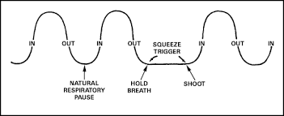
3. Breath Control
The body moves when breathing. Use breath control to minimize such movement.
  Pause breathing momentarily while firing the shot! (Respiratory pause)
Notes:
Use Laser bore sighter to show the movement of a gun while breathing.

Slide 62
Shooting Fundamentals
Trigger Control
Trigger control refers to the proper method of activating the trigger to minimize movement that can misalign the sights.
Trigger is pulled straight to the rear in a smooth, continuous manner without disturbing the sight alignment.
Gradually and evenly increasing pressure until the mechanism releases.
SURPRISE yourself when the gun fires.
Hold Trigger back until bullet hits paper
Slowly release Trigger
Notes:
Scary Triggers…….. No dragging wood, and finger tip on the trigger. No yanking the trigger.

Slide 63
5. Follow-Through
In Rifle Shooting:
Follow-through means to maintain aiming (perfect sight alignment and acceptable sight picture), breath control, hold control, and trigger control until the gun settles back into the aiming area after firing.
63
Notes:
If you have perfect follow through you should know exactly where your gun was aimed when the trigger broke. Allowing you to call your shot.

Slide 64
Shooting Fundamentals
The Fundamentals…A Review
“Maintaining perfect sight alignment and acceptable sight picture.” –
“Pause breathing.” –
“Holding still.” –
“Moving only your trigger finger.” –
“To maintain position, and continue aiming, breath control, hold control, and trigger control until the gun settles back into the aiming area after the shot is fired.” –
AIMING
BREATH CONTROL
HOLD CONTROL
TRIGGER CONTROL
FOLLOW-THROUGH

Slide 65

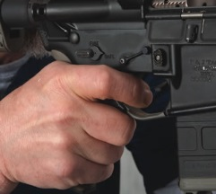
Most Important
Shooting Fundamentals
The two most important fundamentals are:
Aiming
Trigger Control

Slide 66
NRA Gun Safety Rules
ALWAYS keep your gun pointed in a safe direction
ALWAYS keep your finger off the trigger until ready to shoot
ALWAYS keep your gun unloaded until ready to use
Notes:
Go over safe handling of fire arms. How to transport them, Passing them to others. Making sure both people know it’s unloaded
Don’t relay on a safety it’s a mechanic device that can break

Slide 67
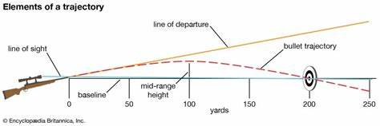
Inches, Minutes, and Clicks

Slide 68
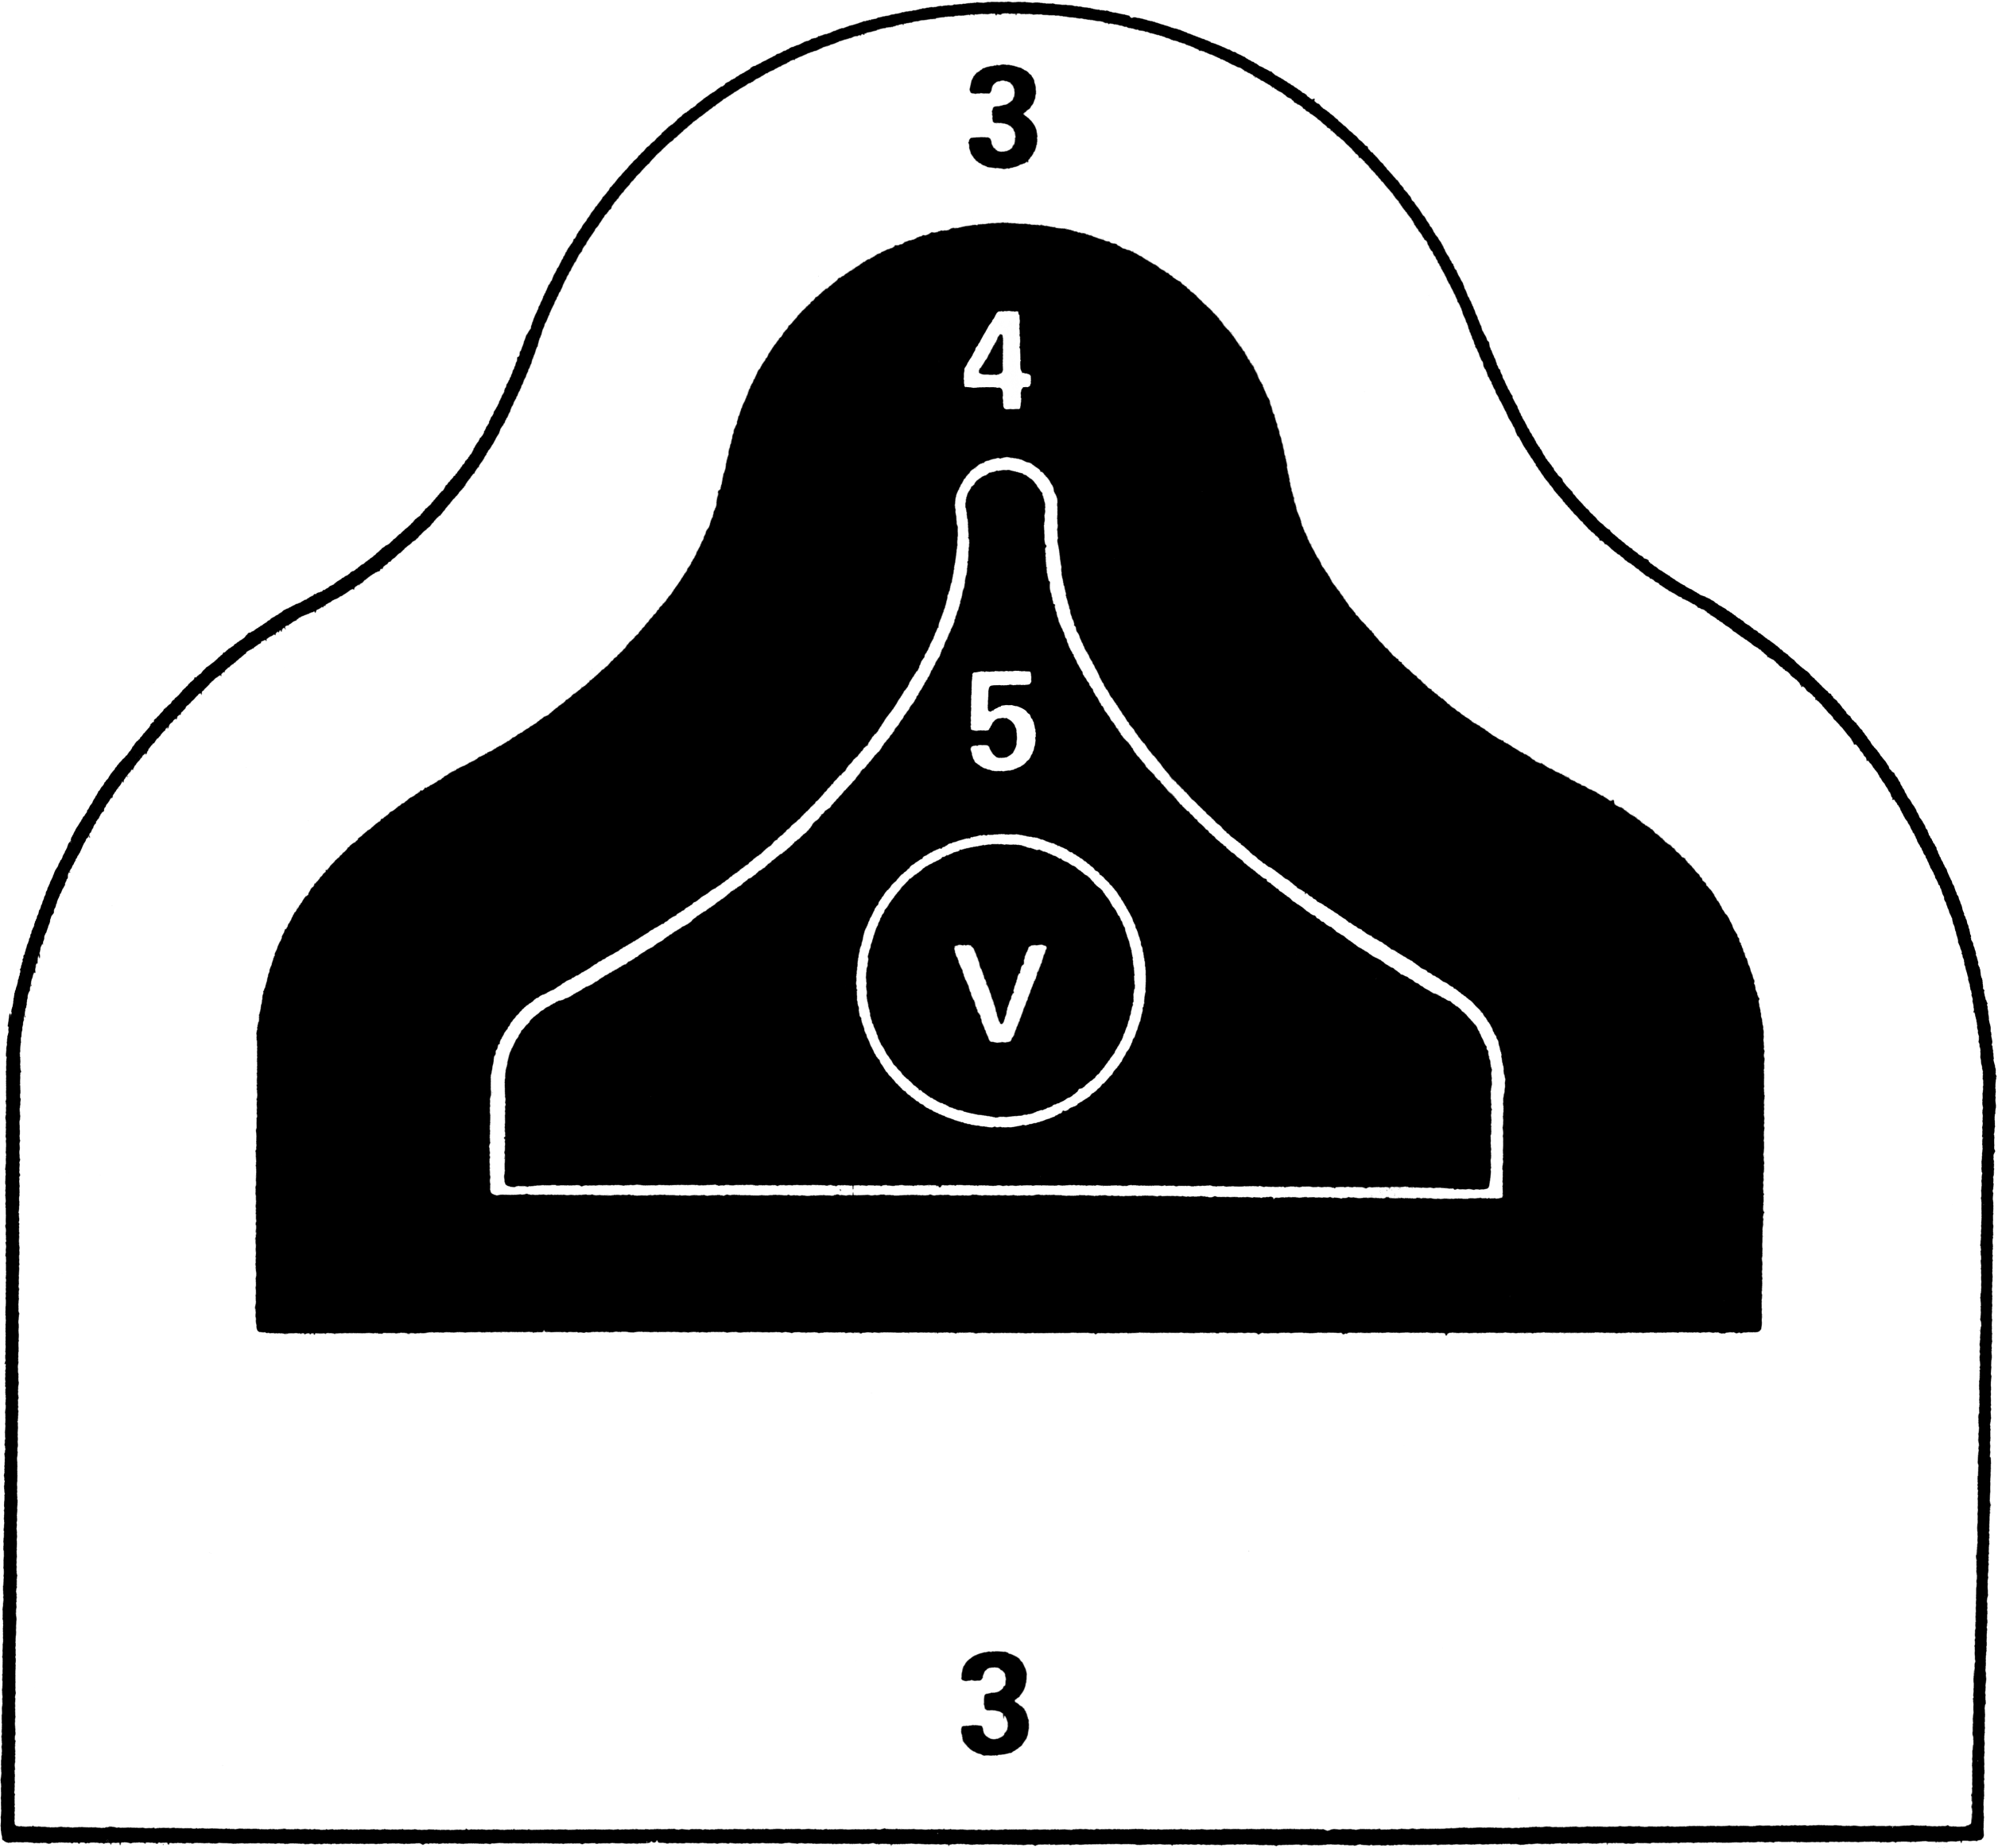
Inches, Minutes, Clicks
20”
16”
12”
8”
4 MOA
4”
2”
1”
4”
5”
1 MOA
2”
3”
1”
Yards
25
50
100
200
300
400
500
1.5”
2.0”
2.0”
2.0”

Slide 69
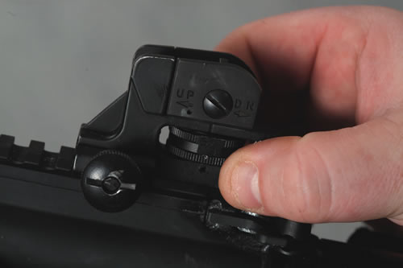
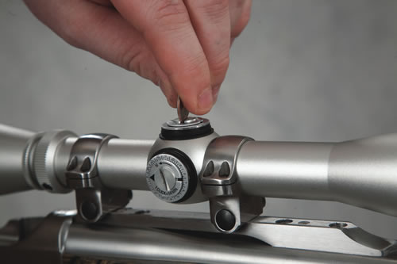
Adjusting the Sights
Shoot a group of 3-5 Shots.
Move the rear sight in the same direction you want the hits on the target to move.
Follow F.O.R.S. or instructions on Scope
Guns MUST BE UNLOADED before making sight adjustments.

Slide 70
NRA Gun Safety Rules
ALWAYS keep your gun pointed in a safe direction
ALWAYS keep your finger off the trigger until ready to shoot
ALWAYS keep your gun unloaded until ready to use
Notes:
Go over safe handling of fire arms. How to transport them, Passing them to others. Making sure both people know it’s unloaded
Don’t relay on a safety it’s a mechanic device that can break

Slide 71
Caring for the Rifle
It is important that you take proper care of the rifle through preventive maintenance.
The rifle should be cleaned and lubricated at the end of each shooting session.
The rifle must always be checked to ensure it is unloaded before it is cleaned.
NO ammunition should be present when the rifle is being cleaned.

Slide 72







Gun Cleaning Procedure
Remove Bolt
Apply Solvent
Unload
Attach Jag
Use Patch
Clean Bore
Use Brush

Slide 73

Cleaning Equipment
Cleaning rod
Bronze or nylon brush and jag of the proper size
Bore solvent
Cotton patches
Small brush (for cleaning residue out of crevices)
Soft cloth
Gun oil
No Ammunition Should be Present When Cleaning Your Rifle.

Slide 74
NRA Gun Safety Rules
ALWAYS keep your gun pointed in a safe direction
ALWAYS keep your finger off the trigger until ready to shoot
ALWAYS keep your gun unloaded until ready to use
Notes:
Go over safe handling of fire arms. How to transport them, Passing them to others. Making sure both people know it’s unloaded
Don’t relay on a safety it’s a mechanic device that can break

Slide 75
Range Safety Briefing
Range layout
  Ready Area
  Firing Line
  Target Area
  Back Stop

Slide 76
Range Commands
Range Commands
  “Prepare Magazine” – for rifles with a magazine
  “Load” you may load one round or insert magazine
  “Fire” you may fire the rifle when you are ready
  “Cease Firing” This means stop firing IMMEDIATLY. No “One Last Shot”. Wait for instructions

Slide 77
Range Commands
The “Cease Fire” command is not restricted to use by the range officer.
Anyone observing an unsafe situation may and should call
“Cease Fire.”

